Slide 1
Introduction to stata
Moses Ngari
mngari@kemri-wellcome.org

Slide 2
Outline
Introduction to stata
Stata window
Log and do-files
Reading, importing and exporting data
Saving data
Data management
Creating & renaming variables
Labelling variables and values
Merging & appending datasets

Slide 3
Outline2
Exploring data
Tabulate and table function
Summarize function
“if” and bysort function
Graphing
Descriptive statistics
Means, variance and SD
Median, IQR, min, max
Tabulate
Proportions and 95% CI
Means and 95% CI

Slide 4
Outline3
Inferential statistics
Test of means (z-test/t-test)
ANOVA
Chi-square test/Fisher’s exact
Proportions comparision
Regression modelling
Linear regression
Logistic regression

Slide 5
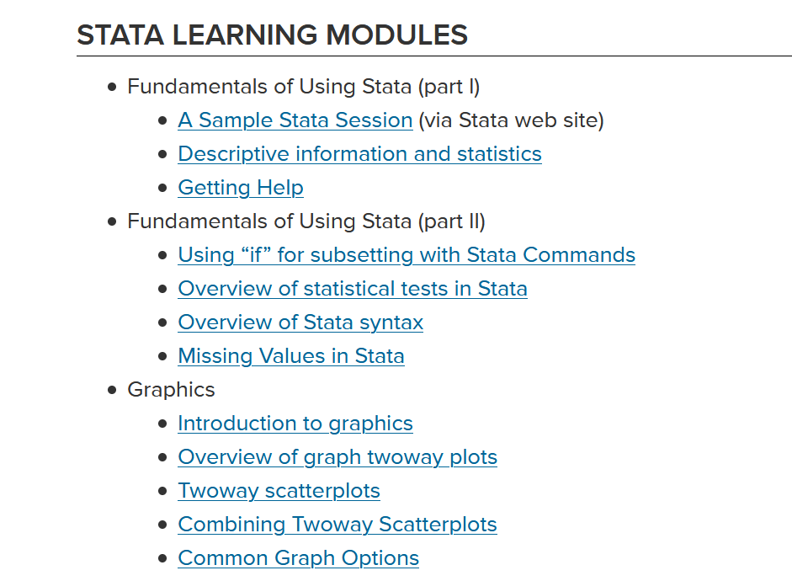
https://stats.idre.ucla.edu/stata/modules/

Slide 6
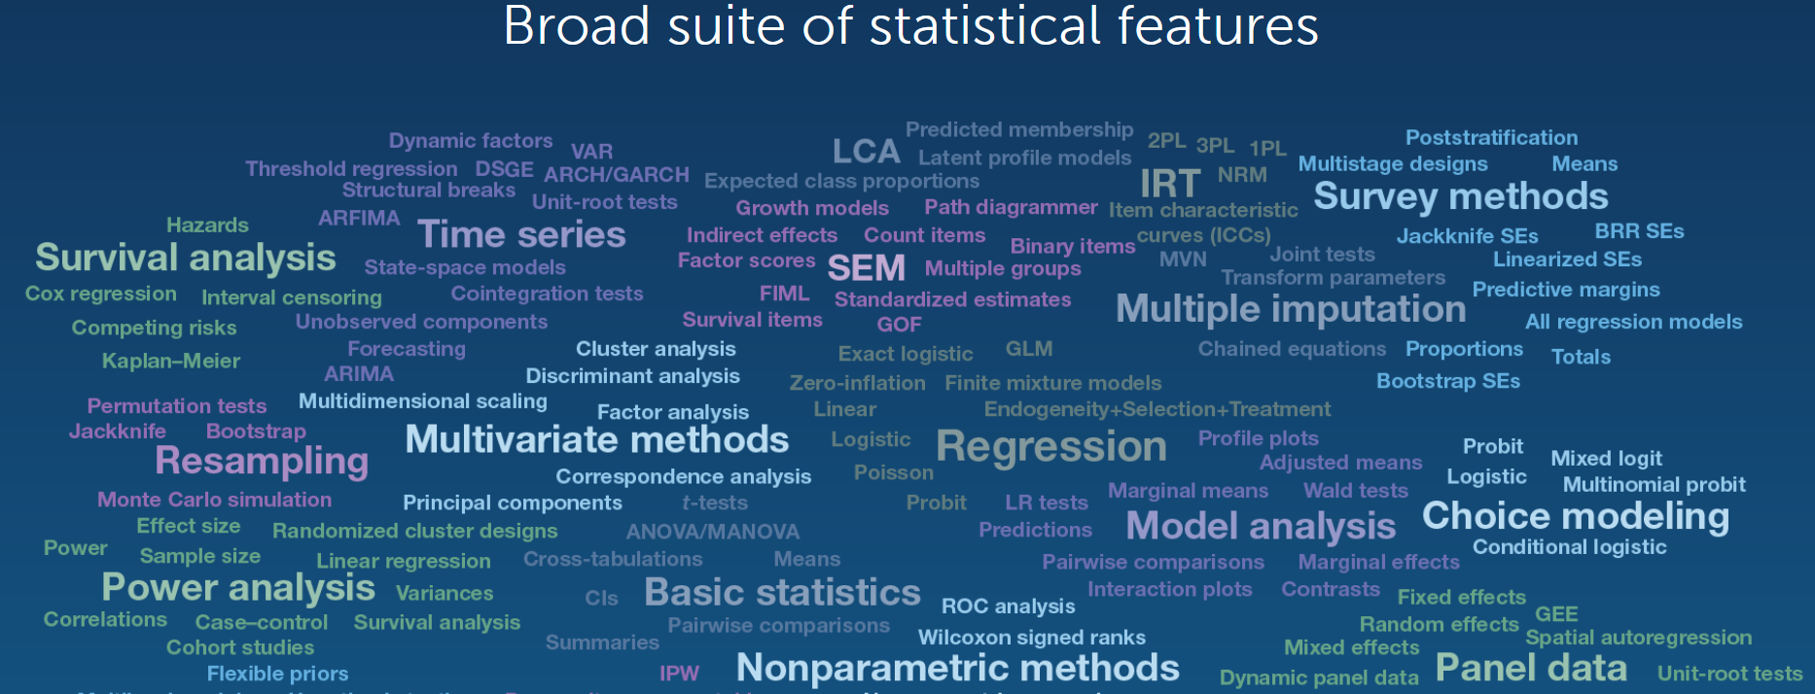

Slide 7
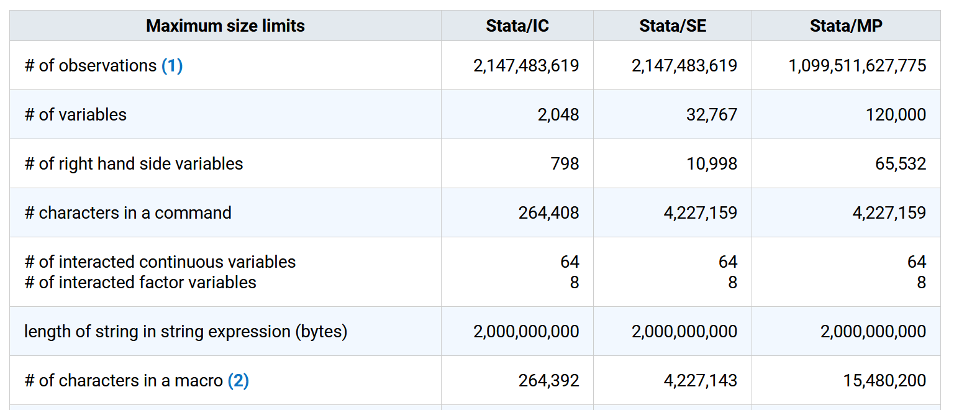

Slide 8
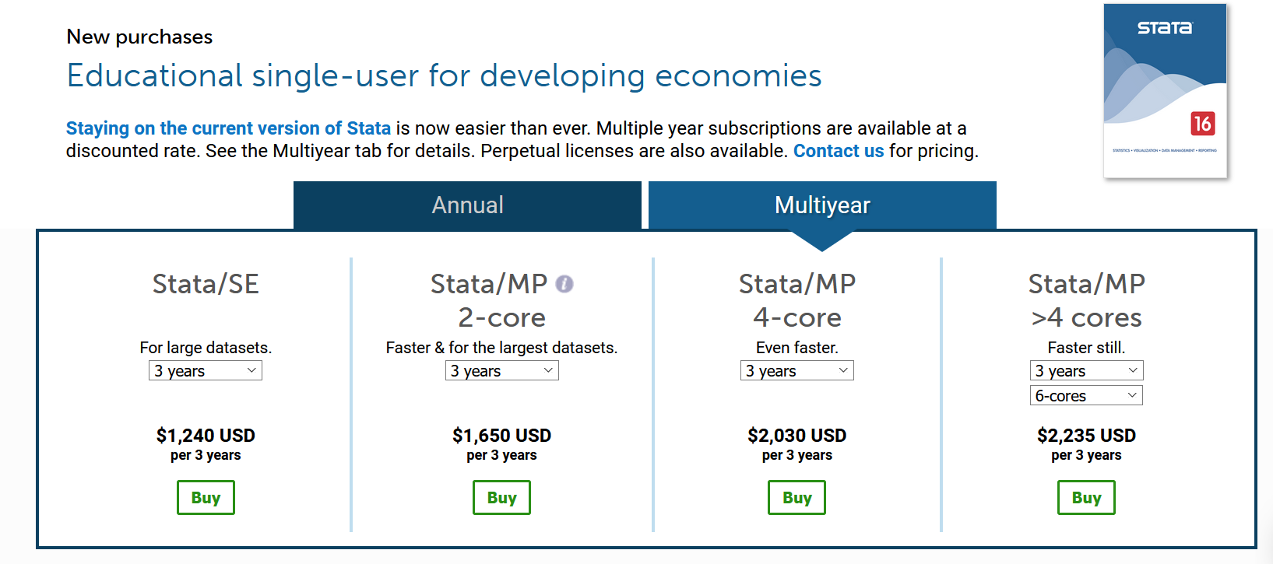

Slide 9
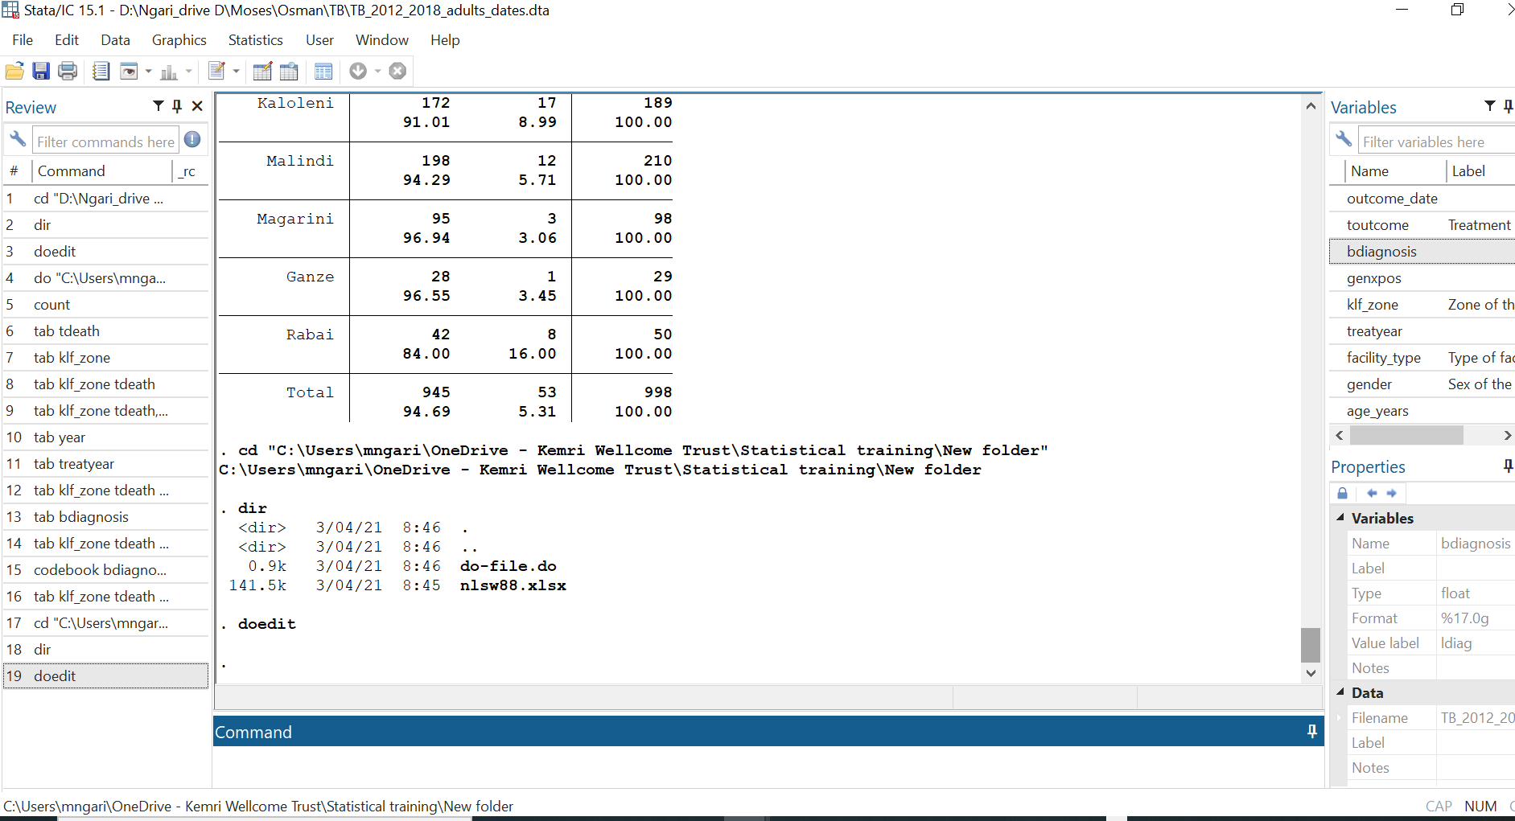
Name of dataset
History of commands, this window
Variables in dataset here
Output here
Property of each variable here
Files will be saved here
Write commands here

Slide 10
To see your working directory, type
pwd
To change the working directory to avoid typing the whole path when calling or saving files,
type: cd
Use quotes if the new directory has blank spaces, for example
cd “h:\stata and data” h:\stata and data. cd "h:\stata and da

Slide 11
To see your working directory, type
pwd
To change the working directory to avoid typing the whole path when calling or saving files,
type: cd
Use quotes if the new directory has blank spaces

Slide 12
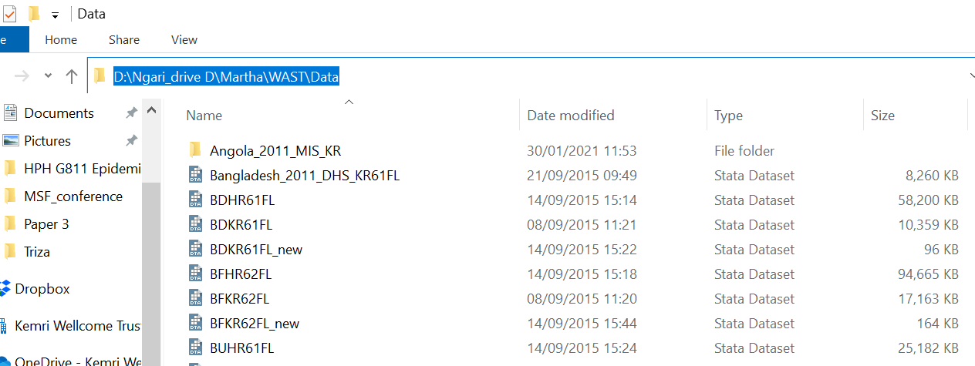
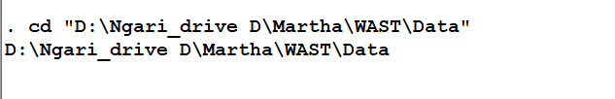
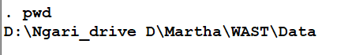
Copy the link
Type this

Slide 13
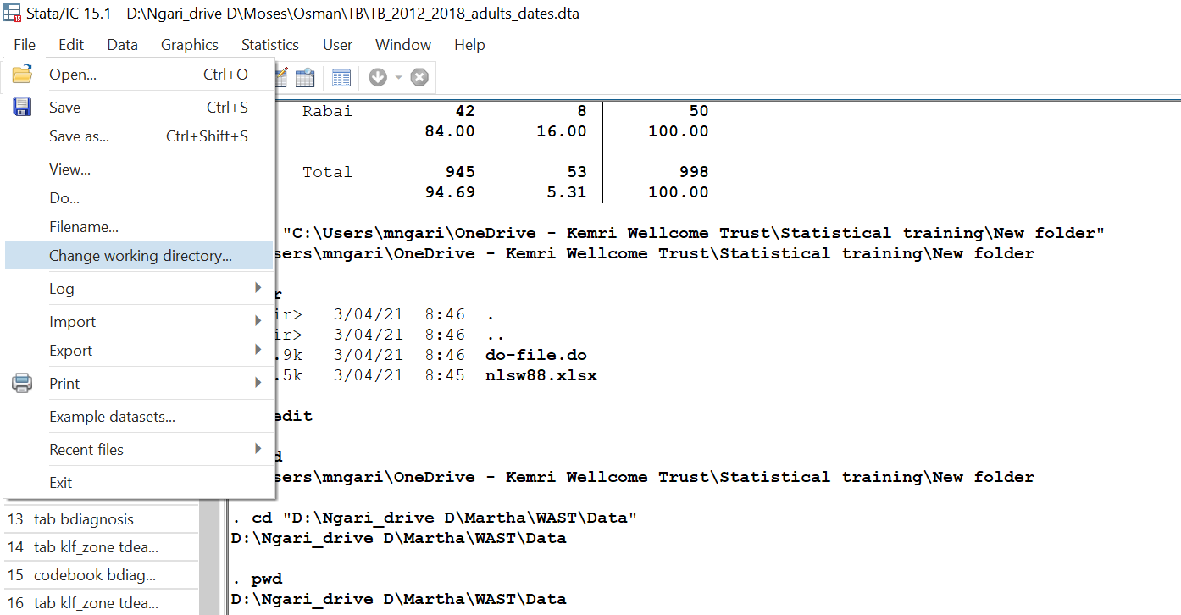
Select the folder you want to work from

Slide 14
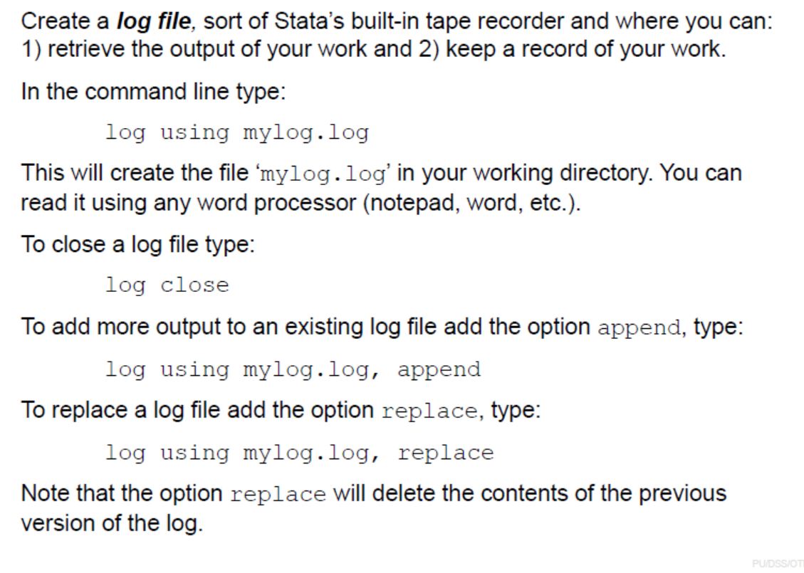

Slide 15
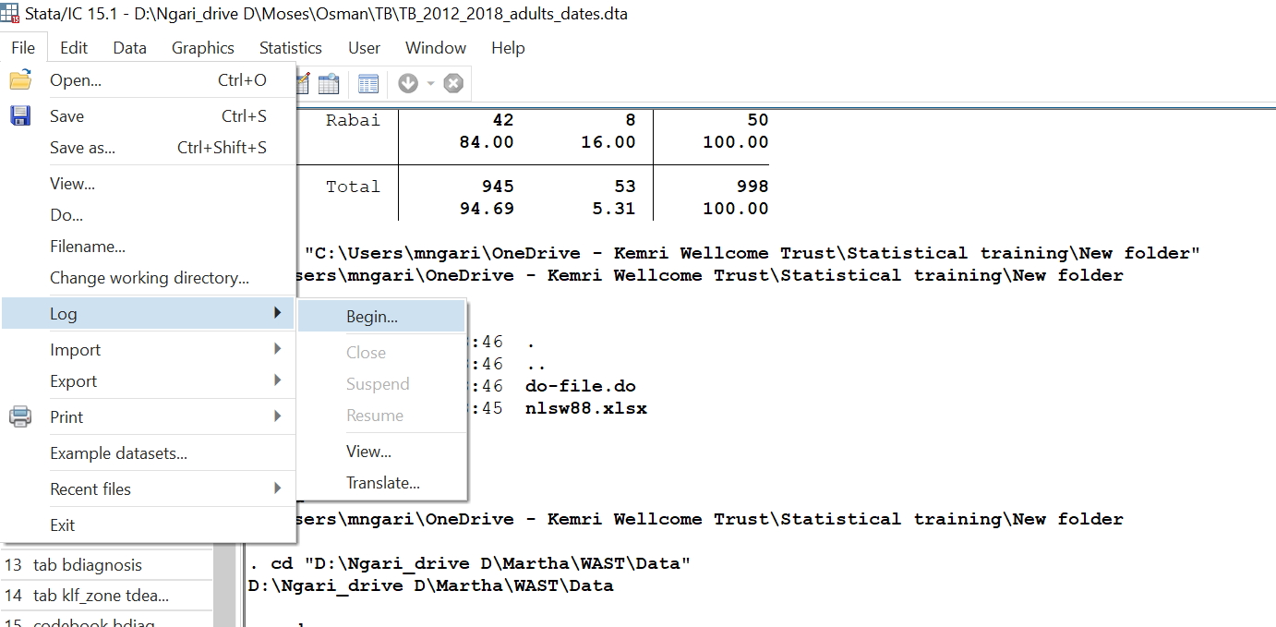
Provide the name and type of the log file

Slide 16
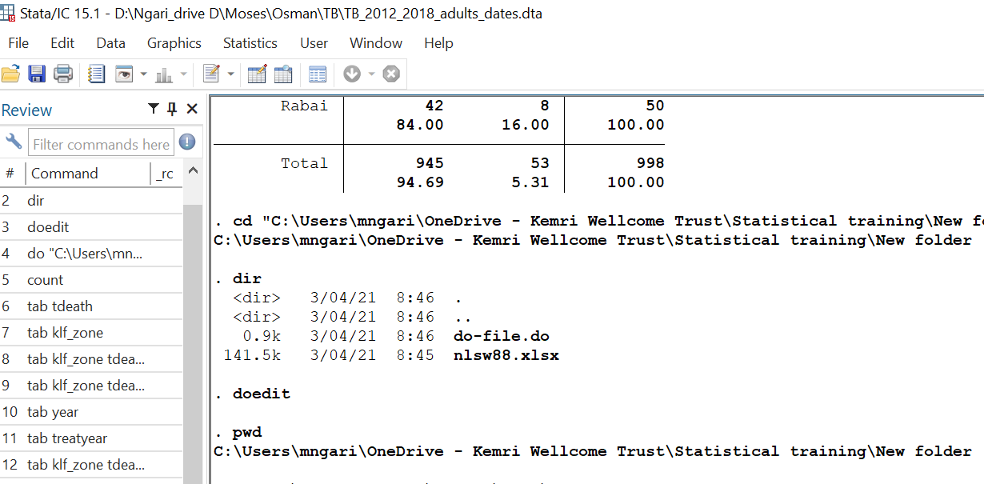
Create do-file
Do-files are ASCII files that contain of Stata commands to run specific procedures. It is highly recommended to use do-files to store your commands so do you not have to type them again should you need to re-do your work.
You can use any word processor and save the file in ASCII format, or you can use Stata’s ‘do-file editor’ with the advantage that you can run the commands from there. Either , in the command window type:
doedit
Click this icon to start new do-file

Slide 17
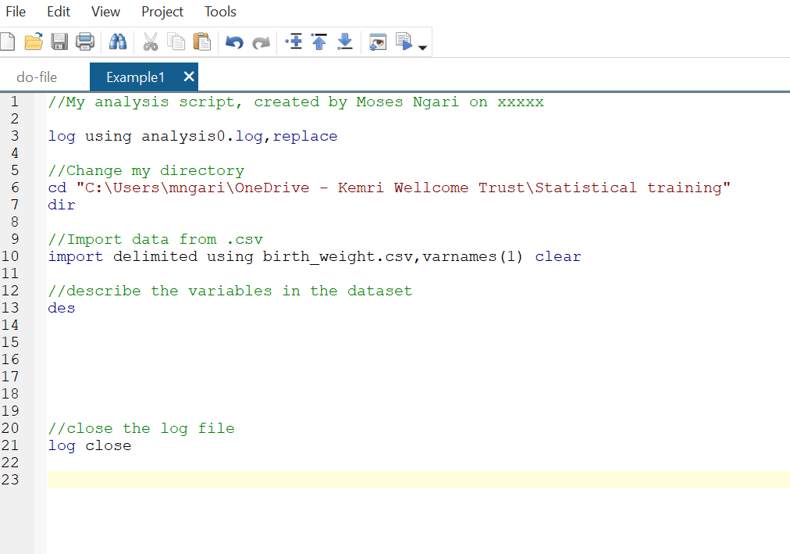

Slide 18
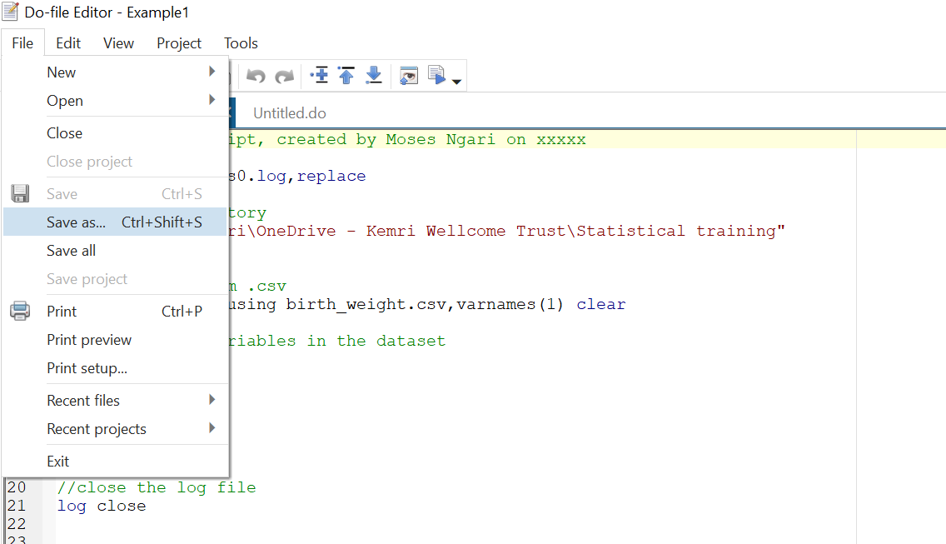
Save the do-file

Slide 19
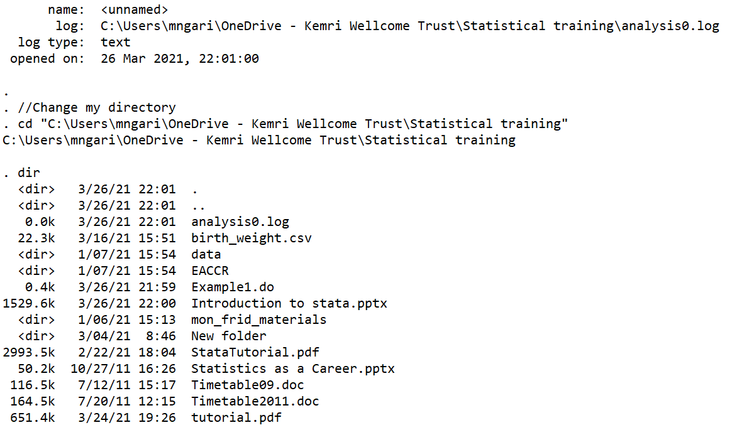

Slide 20
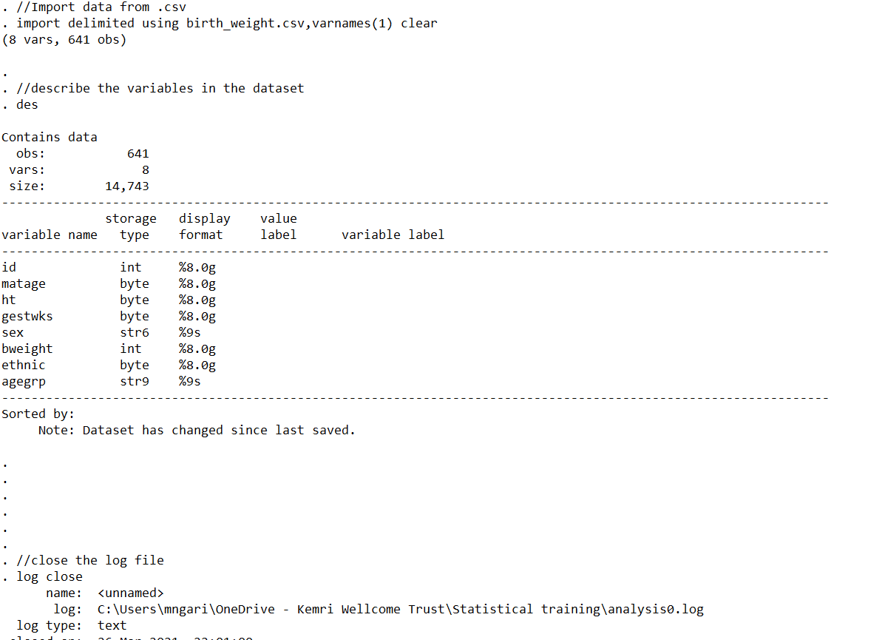

Slide 21
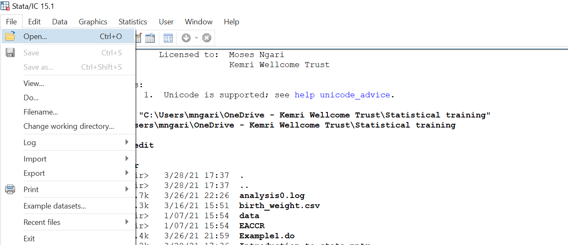
Reading data to stata
Read data already in stata format
To open files already in Stata with extension *.dta, run Stata and you can either:
Type: use data_name,clear
Open the file with stata data

Slide 22
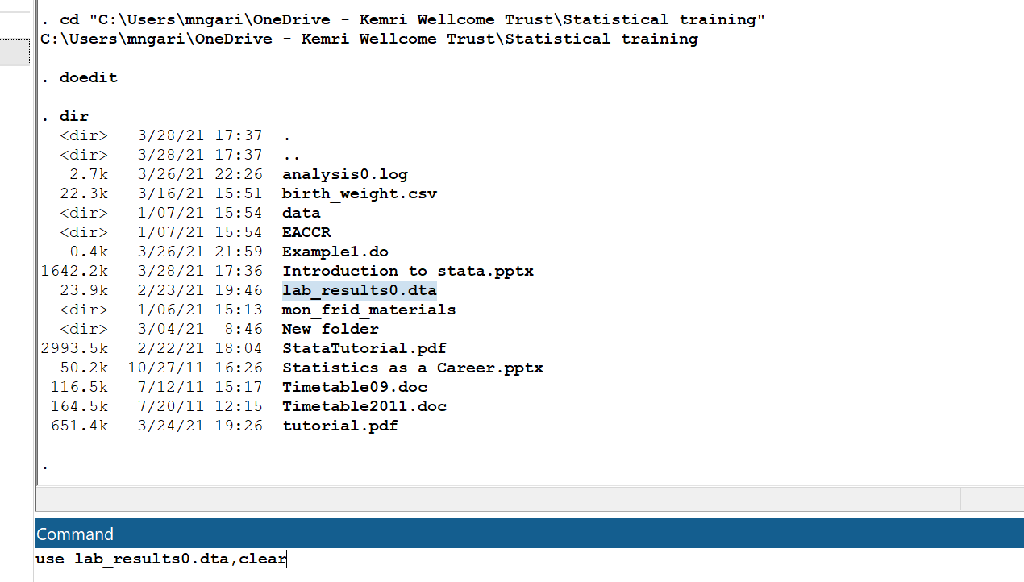
Type: use lab_results0.dta,clear

Slide 23
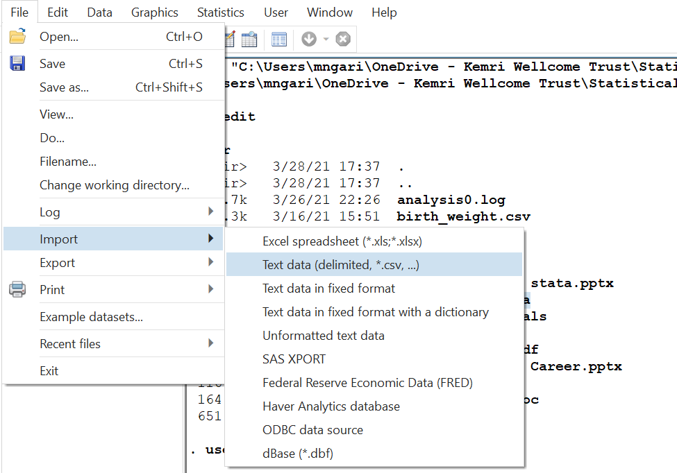
Read data from .csv

Slide 24
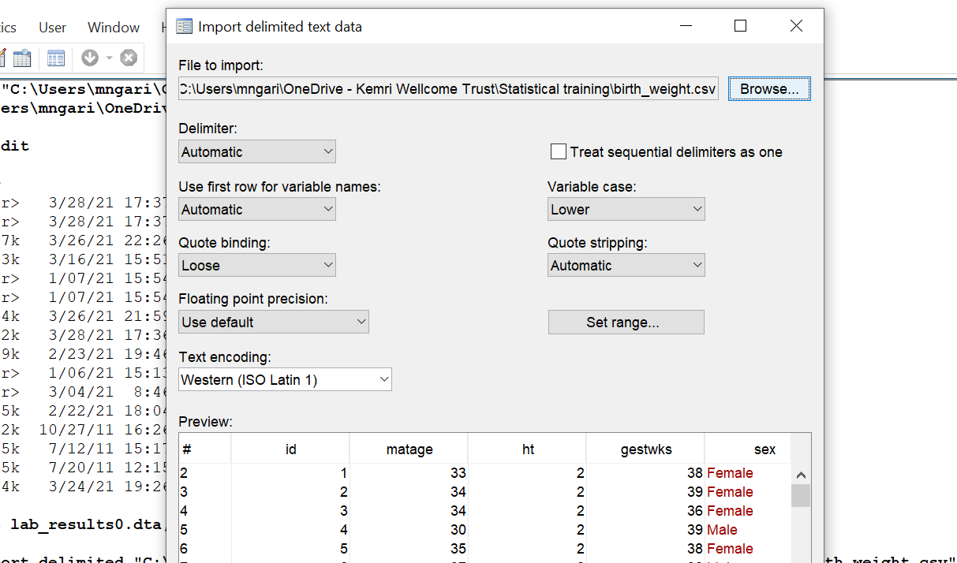

Slide 25
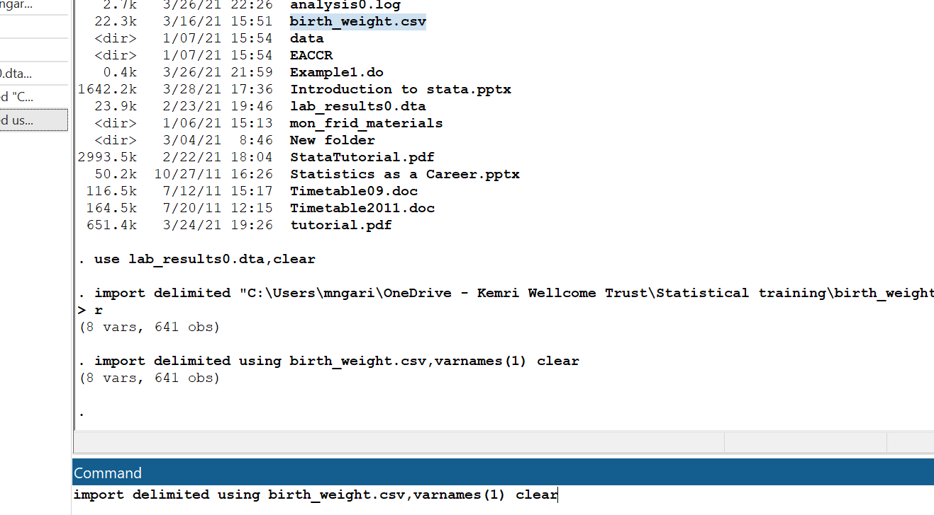
Type this

Slide 26
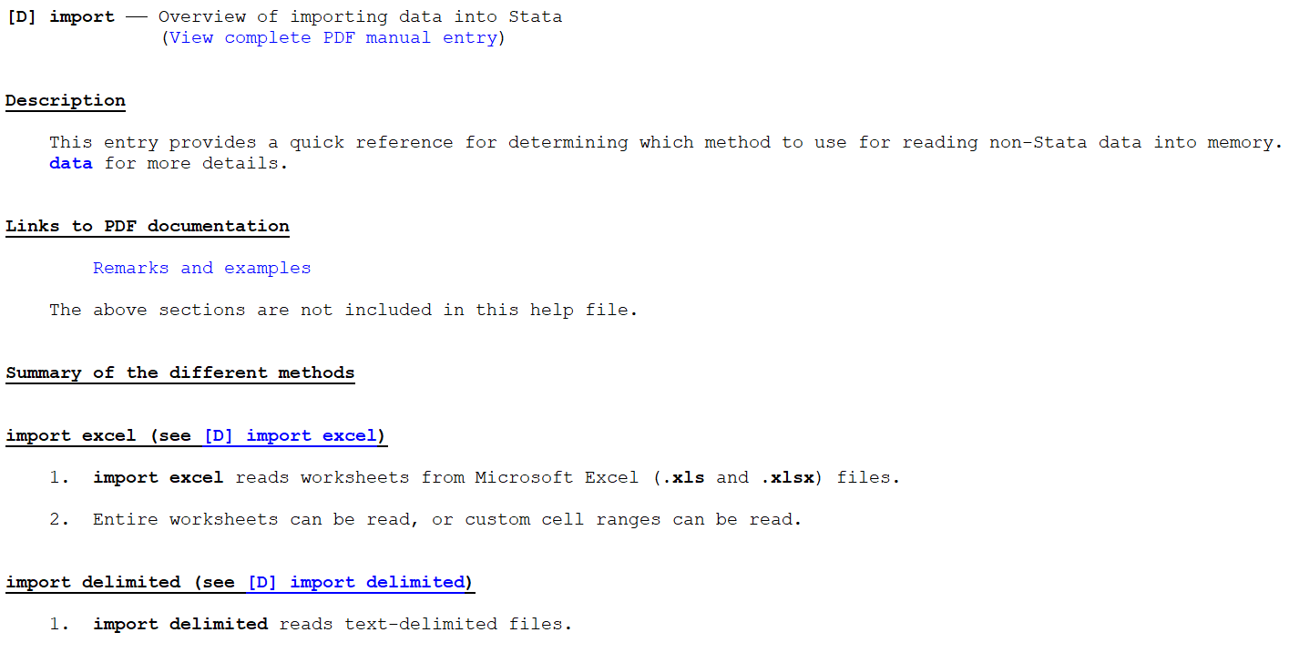
Import other type of data to stata
help import

Slide 27
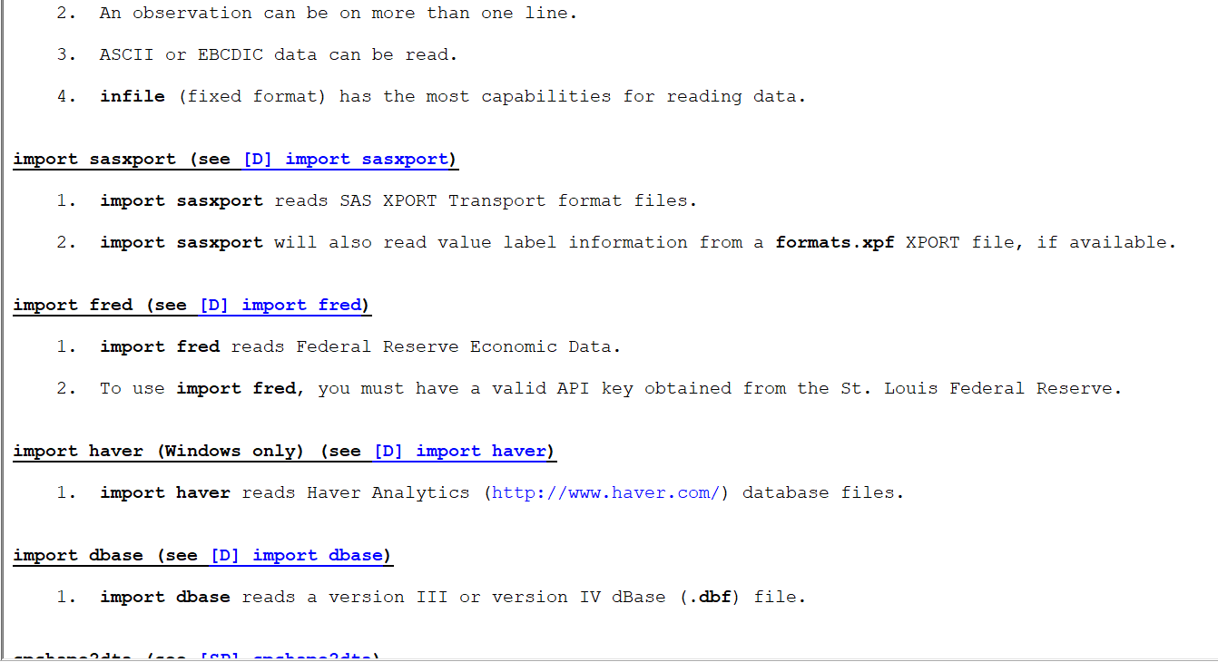

Slide 28
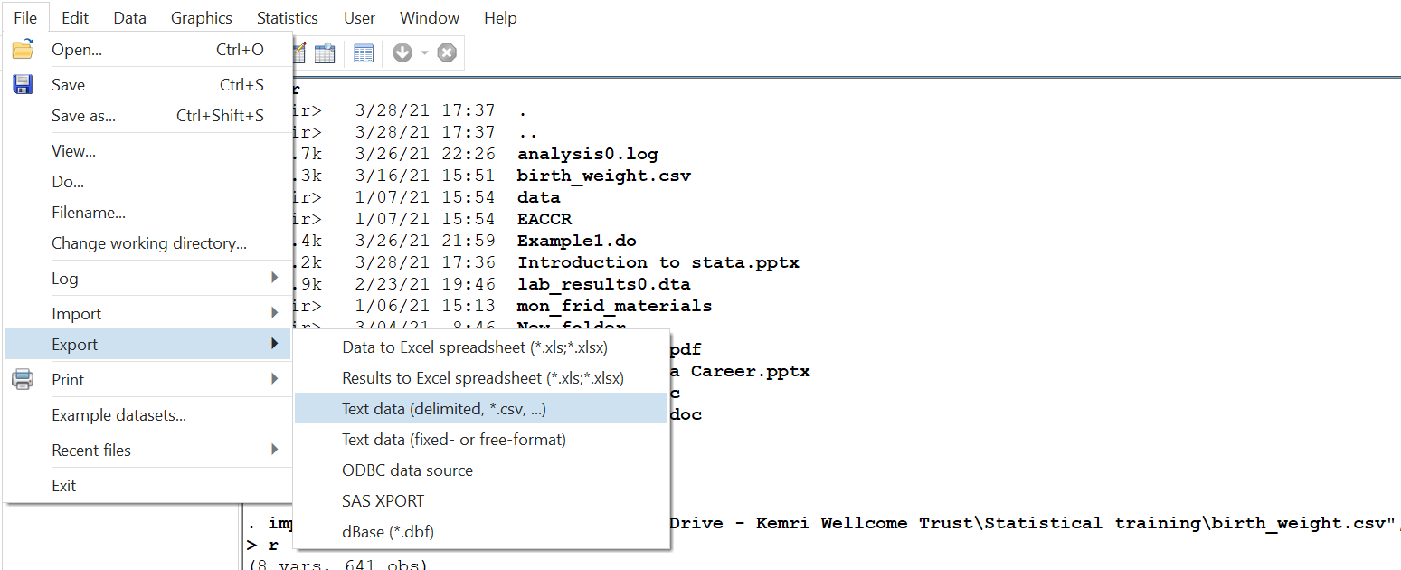
Export data out of stata

Slide 29
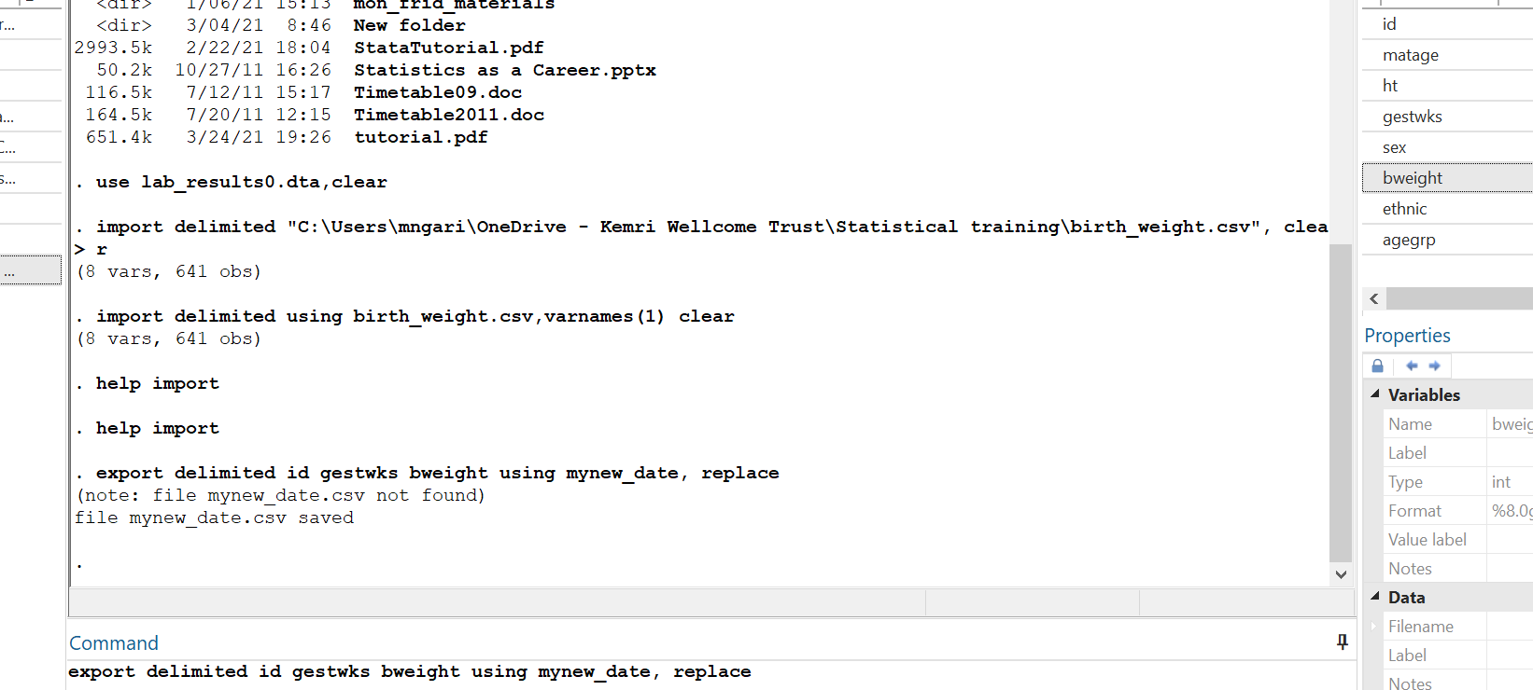
Export function
Variables to export
New dataset name

Slide 30
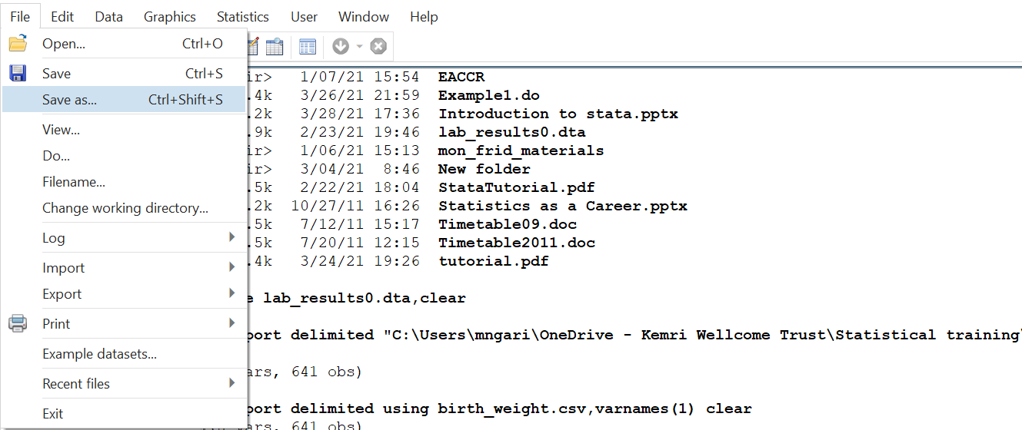
Saving data in stata
Provide the file to save and the dataset name

Slide 31
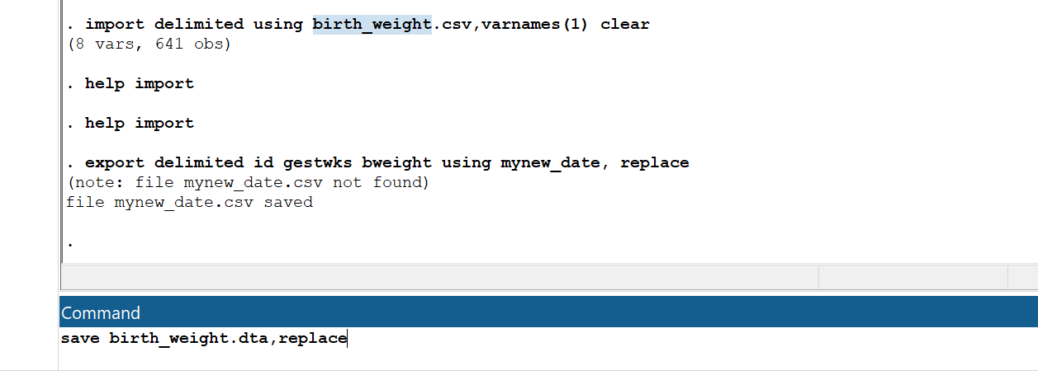
The dataset name
Replace will replace dataset in the memory with that name

Slide 32
Your turn now
Exercise 1
In the folder provided there is a dataset: babies.csv
a) Open a stata window and change directory to the folder with the dataset
b) Open a new do-file
c) read the babies.csv into stata
d) Save as bw.dta
e) save the do-file as: dofile1

Slide 33
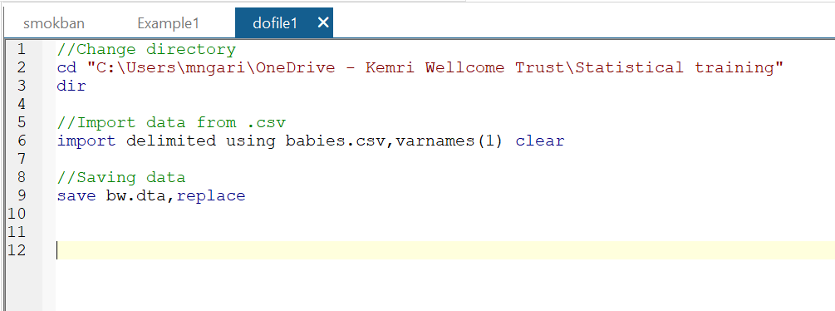

Slide 34
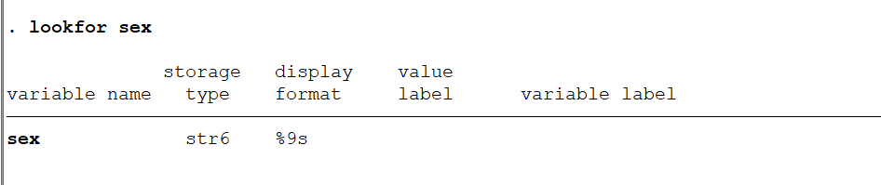
Data management
Import birth_weight.csv dataset to stata
import delimited using birth_weight.csv,varnames(1) clear
You can use the command lookfor to find variables in a dataset

Slide 35
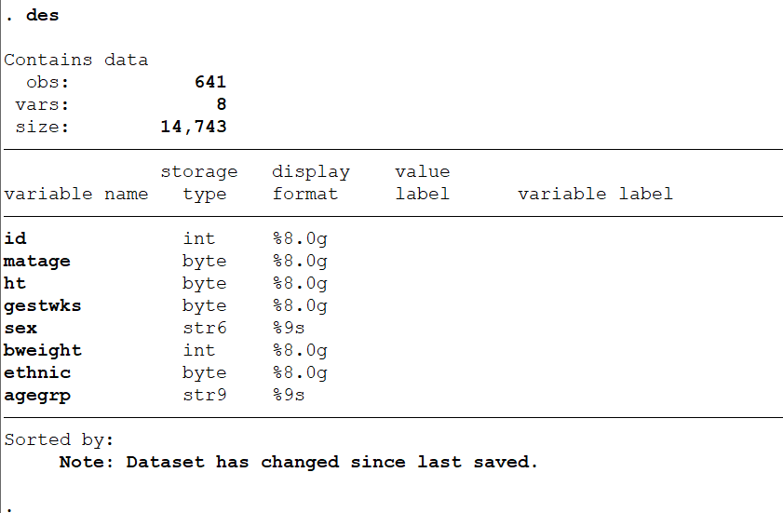
Data variables description

Slide 36
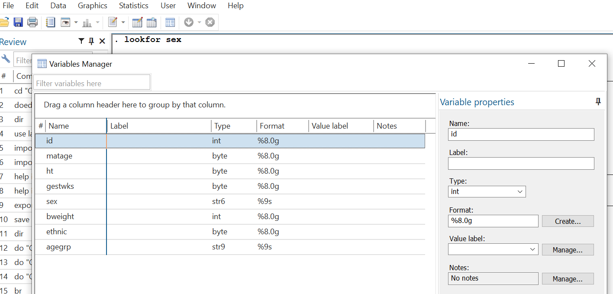
Click hear

Slide 37
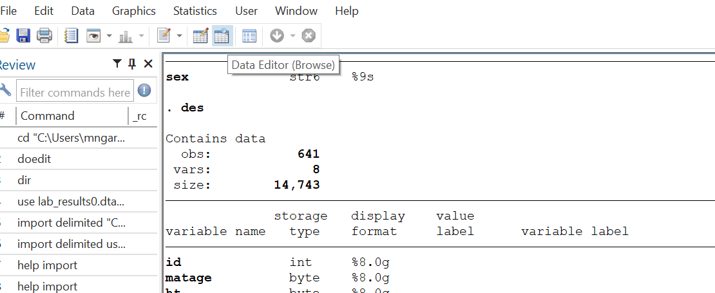
View the variables as spreadsheet
Click here
Type browse

Slide 38
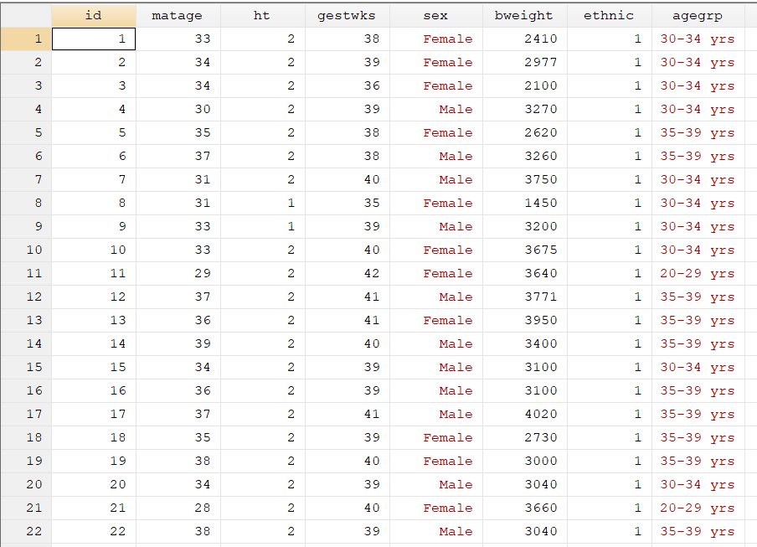
Stata has a color-coded system for each type. Black is for numbers, red is for text or string and blue is for labeled variables.

Slide 39
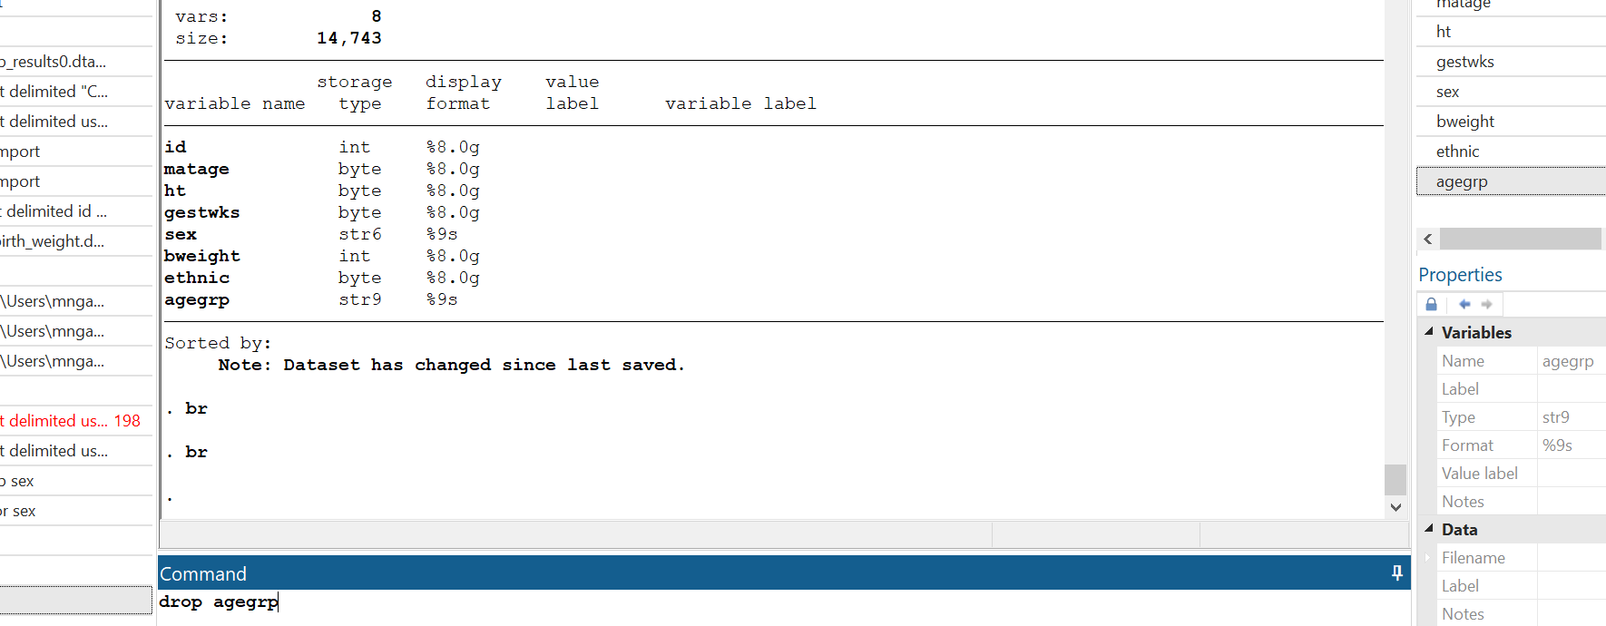
Remove a variable
This will remove the agegrp variable from your data permanently
Type this: drop varname

Slide 40
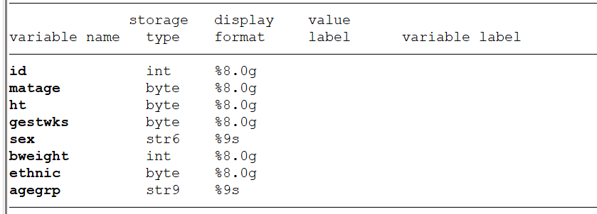
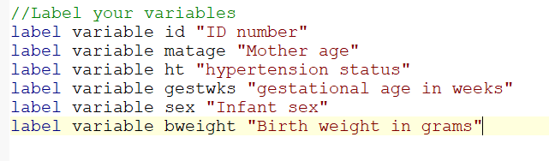
Adding/changing variable labels, type:
Before
Use the function: label variable varname varlabel

Slide 41
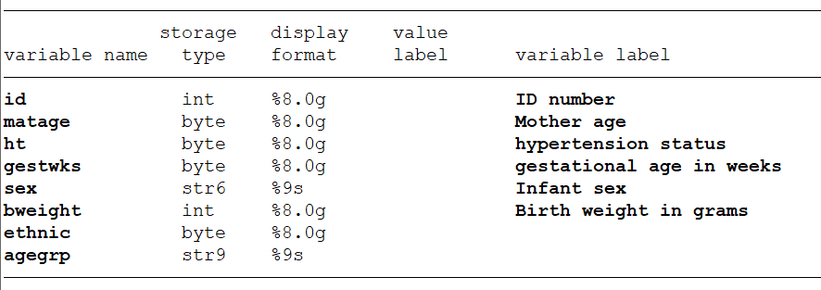
Adding/changing variable labels, type:
After

Slide 42
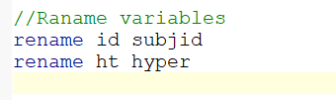
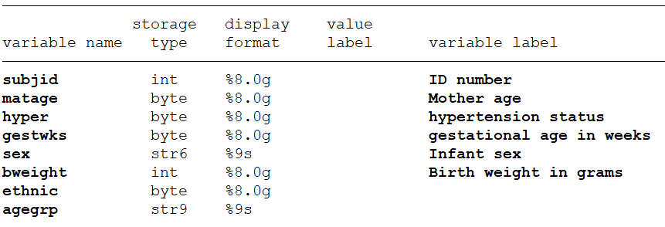
Renaming variables, type:
Before
To rename: rename varname new_varname
After

Slide 43
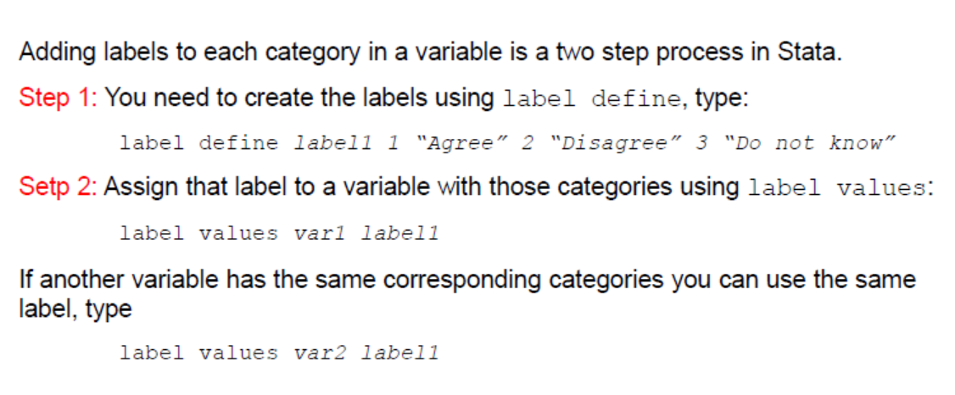
Assigning value labels

Slide 44
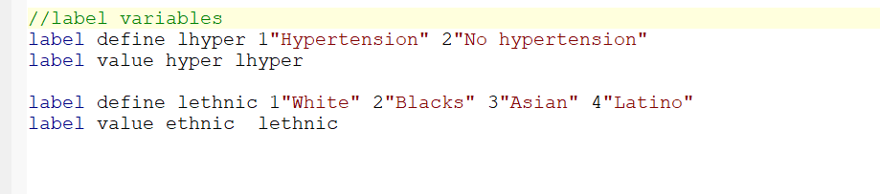
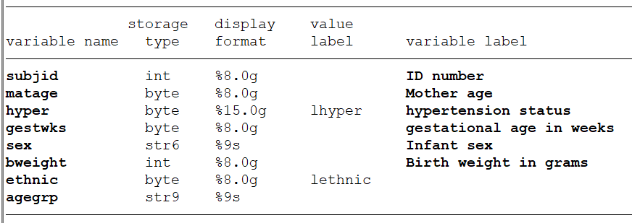
Assigning value labels
You define a label with 1=hyper and 2=not hyper
Assign the define label to variable hyper

Slide 45
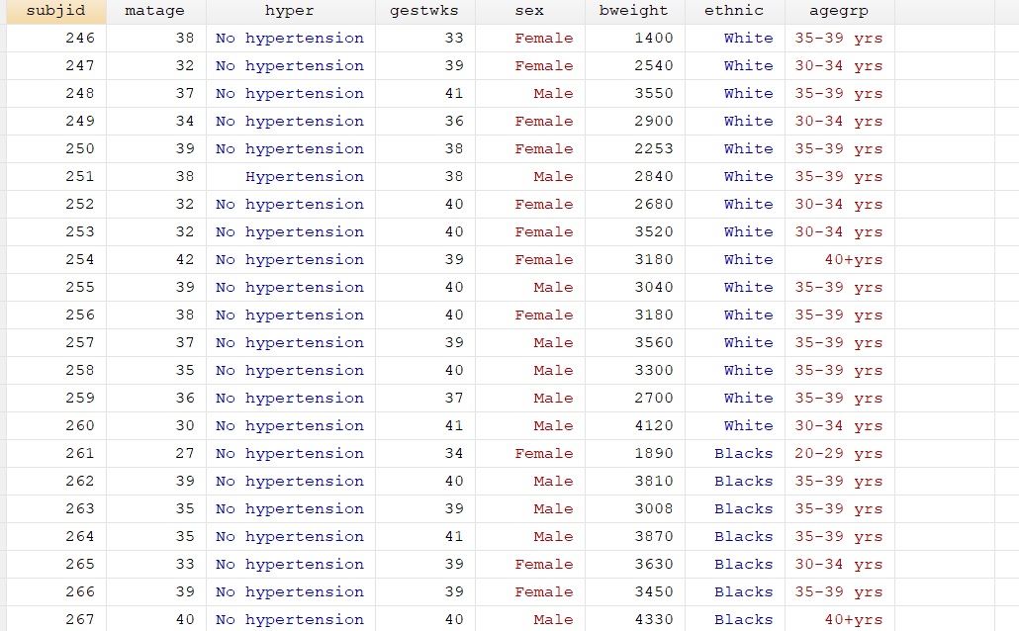

Slide 46
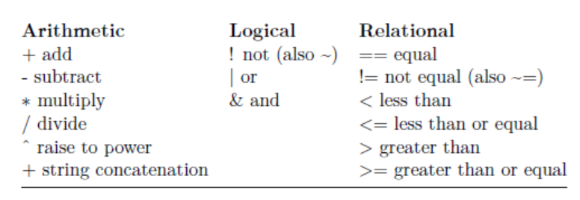
Operators and Expressions

Slide 47
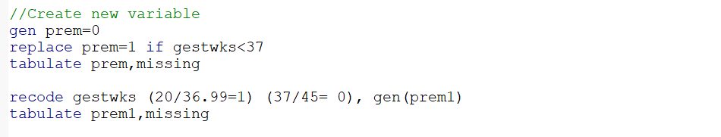
Creating new variables
To generate a new variable use the command generate (gen for short), type
generate [newvar] = [expression]
The variable gestwks is the gestation age in weeks ranging from 25 to 42 weeks. We need to create a need variable called prem for born premature (0=37weeks and above; 1=less than 37 weeks).
Two ways:
Generate a new variable prem with zero and 1 for gestwks<37
The recode function works as well

Slide 48
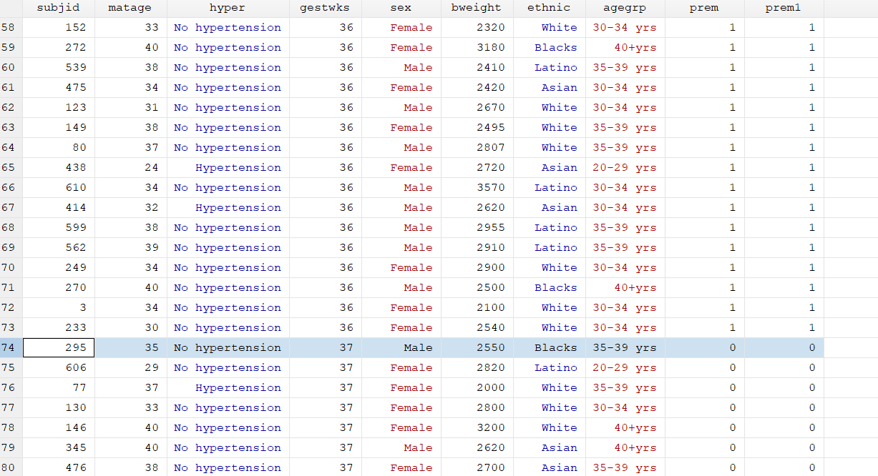
View the data now
br
sort gestwks

Slide 49
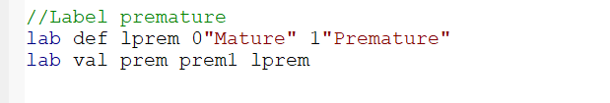
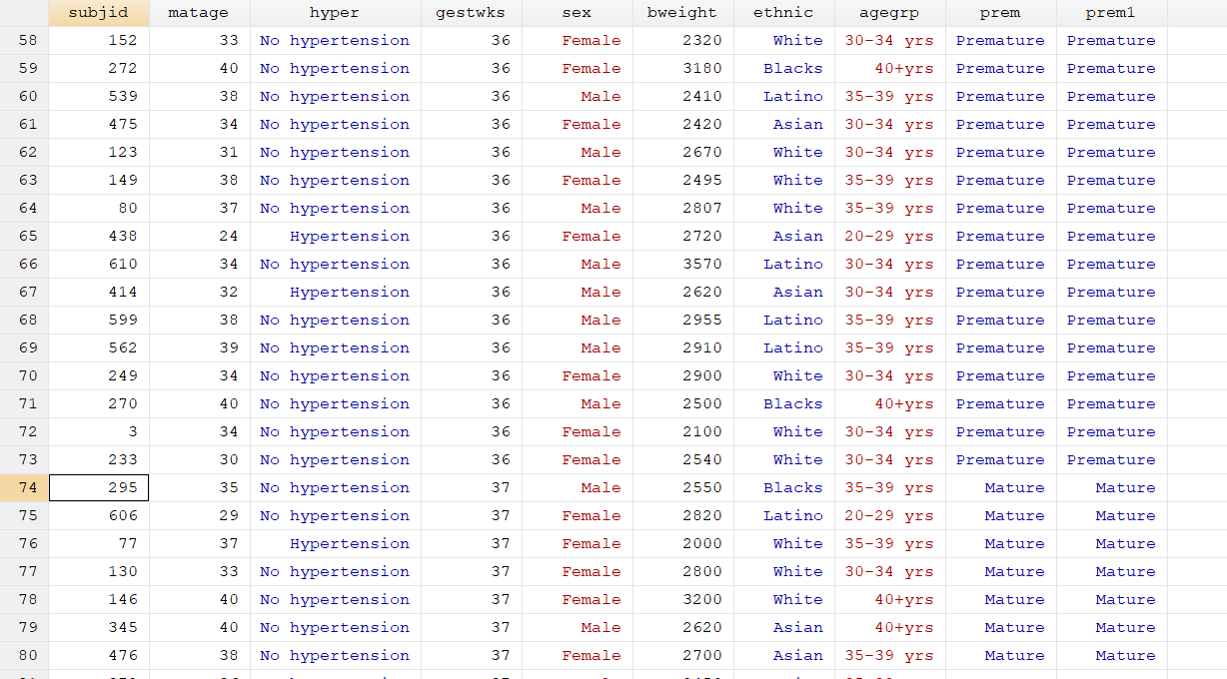

Slide 50
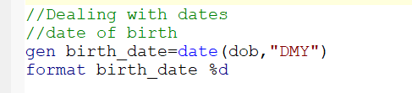
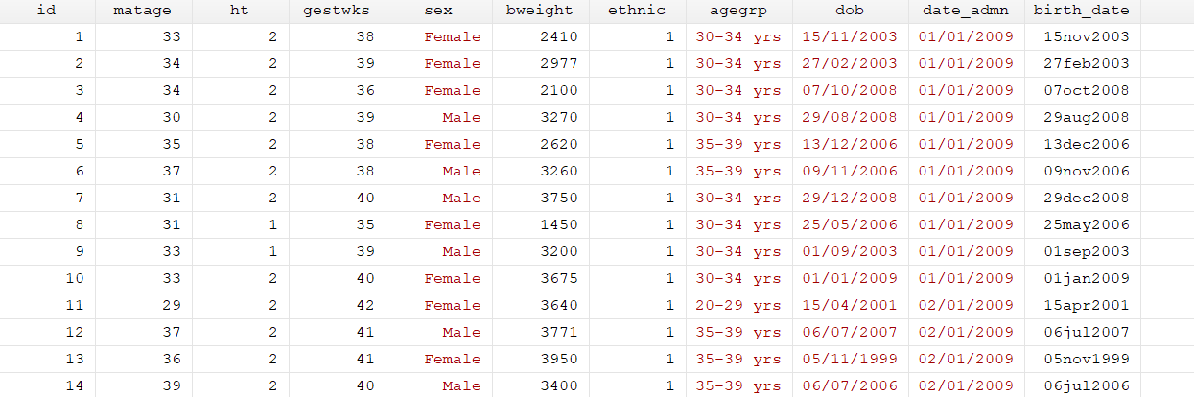
Dates
Dates in stata appear as numbers since 01jan1960. To create a data variable, you first define a “date” variable and provide the correct format
Date as string variable
Date variable

Slide 51
Exercise 2
Read the birth_weight.csv to stata
Use the bweight variable to create a new variable
lbw for low birth weight code as
0 for birthweight >=2500
1 for birthweight <2500
Label the new variable as “Low birth weight”
Attach the variables: 0 “Normal birth weight” 1”Low birth weight”
Create a date variable for date_admn

Slide 52


Change variables type

Slide 53
Merge datasets
Merge – adds variables to a dataset. Type help merge for details. Merging two datasets require that both have at least one variable in common (either string or numeric). If string make sure the categories have the same spelling (i.e. country names, etc.). The common variables must have the same name. Explore each dataset separately before merging. Make sure to use all possible common variables (for example, if merging two panel datasets you will need country and years).

Slide 54

One to one merging

Slide 55

Use the lab_results0.dta data,
Sort the subjid variable
1:1 means each data has one record
Section5.dta the data to merge with

Slide 56


lab_results0.dta
section5.dta

Slide 57


Slide 58


Slide 59


Slide 60

APPEND

Slide 61


Summary in stata
Use tabulate to get summary of categorical variables
Use summarize to get summary of continuous variables

Slide 62

Exploring data
Frequency refers to the number of times a value is repeated. Frequencies are used to analyze categorical data. The tables below are frequency tables, values are in ascending order. In Stata use the command tab varname.
Read the birth_weight.csv
What proportion of children were females?
Freq. provides the count
Percent provides relative frequency

Slide 63

Contingency tables
Contingency tables or crosstabs help you to analyze the relationship between two or more categorical variables.
row provides % by row variable
Var1 var2

Slide 64

col provides the % by the column variable

Slide 65


Exploring data: frequencies and descriptive statistics
Command table produces frequencies and descriptive statistics per category

Slide 66


summarize
Type summarize to get some basic descriptive statistics.

Slide 67

bysort
bysort allows to run simple loop by a variable with many categories

Slide 68

Conditional statement in stata
The "if" Suffix
The “if” command suffix is used to restrict on which data a command is run.

Slide 69


You can combine two conditions: if and &

Slide 70
Exercise 3
Read the birth_weight.csv dataset.
What proportion of children were low birthweight?
What proportion of boys were LBW?
What was the mean age of the mothers?
What was the mean age of mothers in the four ethnic groups?

Slide 71

Graphs
Scatterplots are good to explore possible relationships or patterns between variables and to identify outliers.

Slide 72


Slide 75

Histograms are another good way to visually explore data, especially to check for a normal distribution. Type help histogram for details.

Slide 77
Box plots
Plots medians

Slide 78
Exercise 4
Read the birth_weight.csv dataset.
Plot scatter plot of bweight Vs matage. Add a y-axis line for bweight=2500
Plot a box plot of gestwks Vs sex
Plot histogram of gestwks, add a normal distribution curve

